Slide 1
Protecting Your Senior Market Book of Business in 2017
Mark Lane
GarityAdvantage Agencies

Slide 2
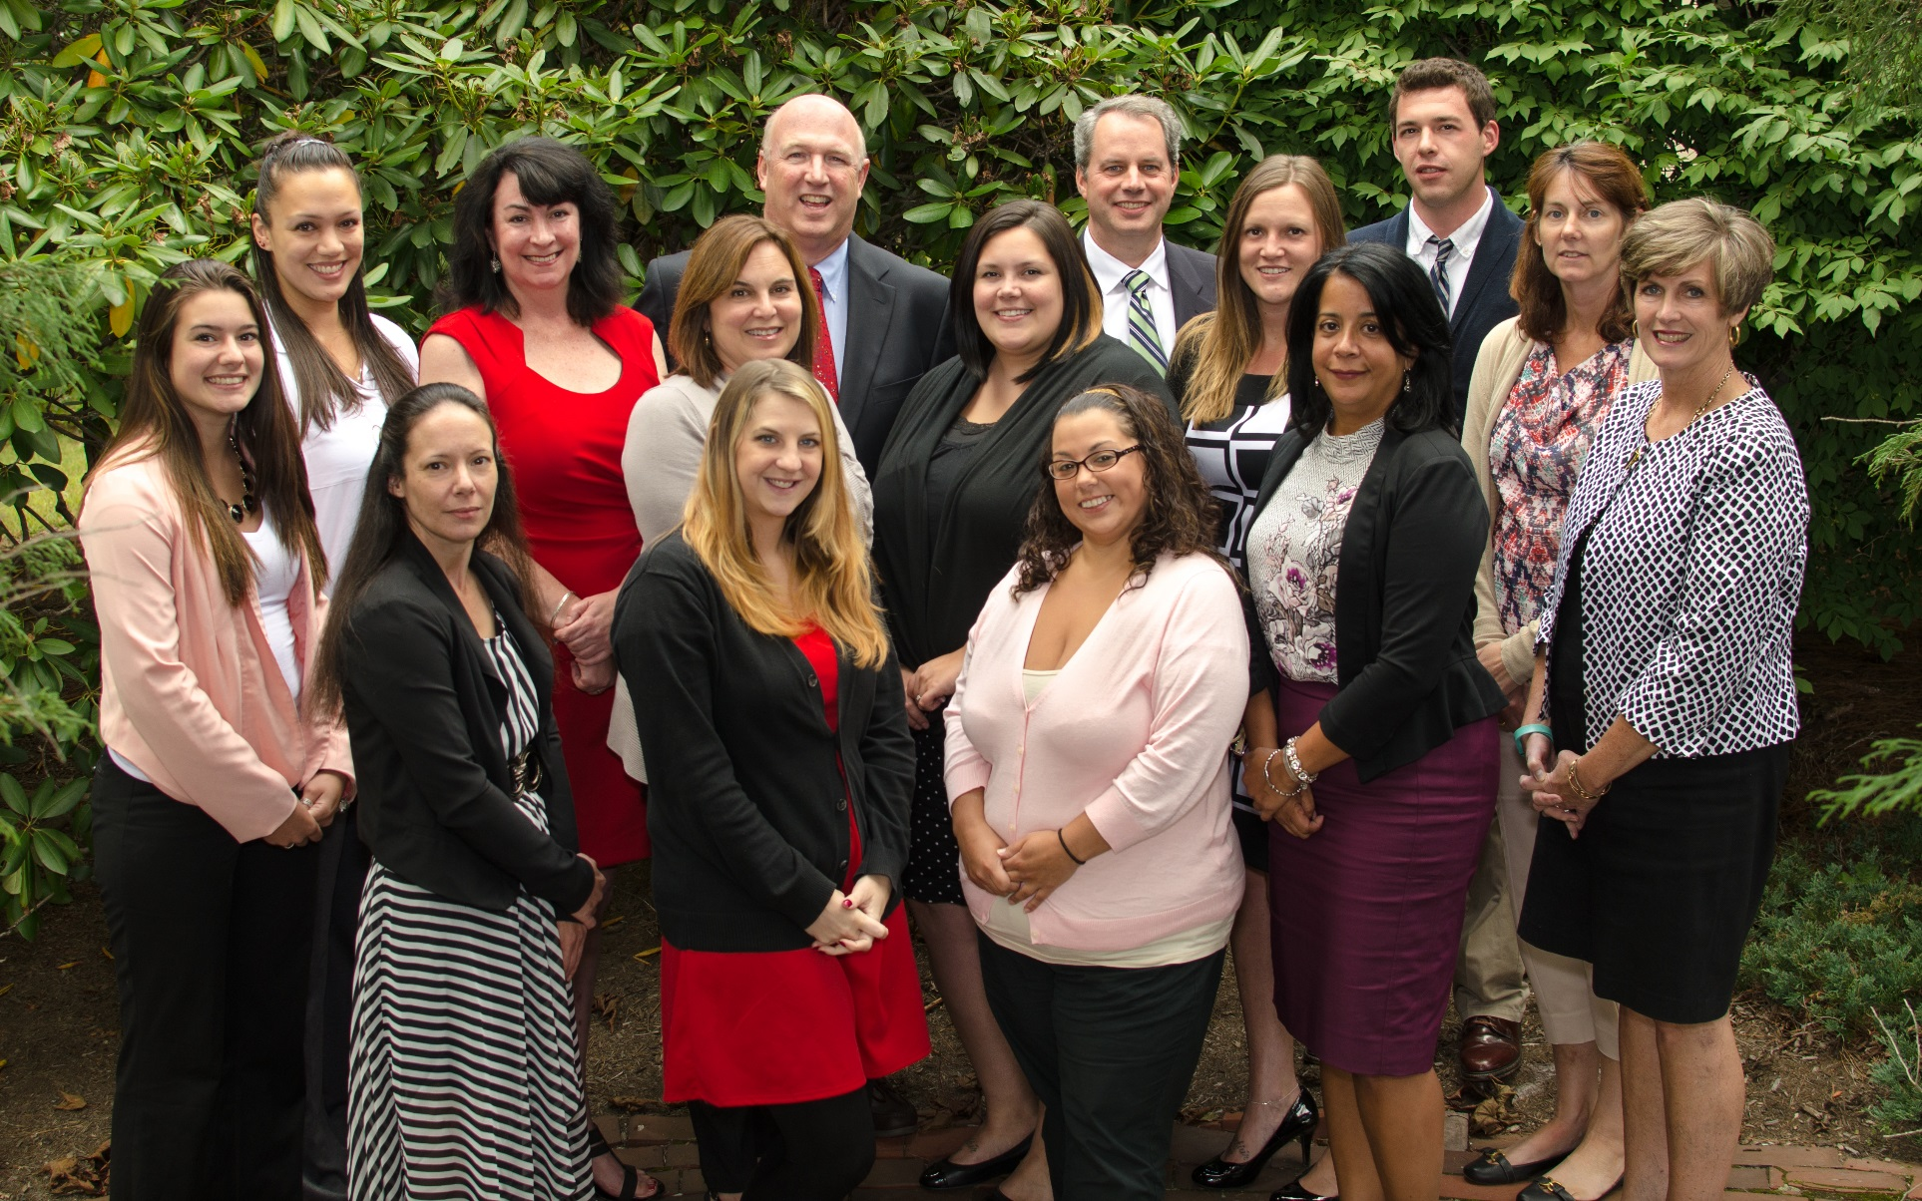
A BIG THANK YOU!

Slide 3
Today’s Agenda
The Problem
The Solution: Structuring Your Business To Protect Your Income
Creating Your Company
Protecting Your Business During the MADP
Medicare Annual Disenrollment Period
Best Practices - Increase Your Brand/Bond With Your Clients
Tools You Can Use
We’re Here to Help

Slide 4
The Problem
Sorry, but you’re going to die or, you’re going to get sick or, you’re just going to get old.
The time may come when you’re just not able and/or willing to service the 500-1,000+ clients you’ve worked so hard to get.
What’s at stake?
In 2017, Renewals are $222 per year ($249 in CT)
This amounts to $111,000 for a book of 500 clients ($124,500 in CT)
What’s your number?

Slide 5
The Problem
If you are contracted as an individual, all that income goes away when you die, leaving your spouse and loved ones with nothing…
Several companies allow you to transfer business via Broker Of Record (assuming you have the time to do it); a few do not.
Per CMS, commissions can be paid only to licensed, contracted and certified brokers. If you are unable to certify, the companies will not pay your commissions.

Slide 6
The Solution
Create a legal entity, transfer your existing business under your new company license.
All new business must be written under the new company license.
What’s the advantage to doing this?
You now have an asset that can be sold by you or your survivors.
All your business will be in one place and may be moved easily to a licensed, certified buyer.
Commissions will continue to be paid to the company as long as there is a license supporting the contract and certification is done annually.

Slide 7
The Solution
How much can I get for my business?
Sale of any block of business usually depends on the renewal income. Oftentimes, the price would be calculated based on a multiple of the annual income. It is a negotiation, but 2, 2.5 or 3 times annual renewals would be most likely.
Example: A broker with a book of 800 clients would be getting $177,600 per year in renewals. A negotiated sale price of 2x earnings would result in $355,200 for the business … a nice nest egg for your surviving spouse or children.
An attorney or “business broker” should be engaged to handle such a transaction.

Slide 8
Structuring Your Business To Protect Your Income
What Do I Need To Do To Get This Set Up?
1st - Talk to your Tax Accountant
Take into account your specific tax situation and determine which is the right approach for you.
Most common business types:
Sole Proprietorship: Simplest business formation--1 person personally responsible for all debts.
Partnership: Legal form of business operation--2 or more individuals share responsibilities.
S Corporation: Appealing tax benefits while providing business owners with the liability protection of a corporation.
C Corporation: Owned by shareholders and treated as independent entity. Owners and shareholders have limited liability towards business debts.
Limited Liability Company (LLC): A business organization with the liability-shield advantages of a corporation and the flexibility and tax pass-through advantages of a partnership.

Slide 9
Creating Your Company
2nd - Once you have determined which approach is the right approach for you, you will most likely need to engage an attorney to draft and file the appropriate documents.
3rd - Once the company is in place, you need to apply for an insurance license through the State Department of Insurance.
4th - When the license is received, you will need to re-contract with each carrier as an agency. When this has been completed, they will issue a new writing number for the agency. Once this is completed, all new business written should be under the agency.

Slide 10
Creating Your Company
5th - Once you have the agency license and the new contract in place, contact GarityAdvantage for assistance in moving your existing business from you, as an individual, to your company.
Please note: every company has different rules regarding how to go about this. Currently, Anthem does not recognize Agencies, only individuals, so this won’t help you with them. Undoubtedly, this will change in time.
Fees – There will be some cost to doing this but, overall it is well worth it. Generally, the cost will probably be somewhere between $2,000 - $3,000, depending on the state.
Accountant and/or Attorney, including filing fees
State licensing fees
The bigger your book of business, the more you have at stake!
Don’t put this off!

Slide 11
Protecting Your Business During the Medicare Annual Disenrollment Period
What You Can and Should Be Doing Right Now to Keep
ON THE BOOKS What You Just WrotE.

Slide 12
MADP
The Medicare Annual Disenrollment Period starts on 1/1 and runs through 2/14.
During this time, MAPD clients have the opportunity to disenroll from their MA plan and revert back to Original Medicare. If they do this, they will get an SEP to enroll in a stand-alone PDP.
Unless they qualify for a D-SNP plan, their only option beyond Original Medicare is to purchase a Medicare Supplement Plan.
This is a period where your newer clients are most at risk.

Slide 13
Common Reasons Why People Disenroll
They did not receive their Welcome Kit, ID card or other “start-up” materials.
Their PCP is listed incorrectly on their ID card.
They have been having difficulty using the plan.
They are having difficulty getting their prescription drugs.
They are confused regarding some of the plan benefits.

Slide 14
Be Your Clients’ Hero
This is a perfect (and timely) opportunity to, not only retain your clients, but also to improve your brand with them. This could lead to other referrals or set up a great cross-selling opportunity.

Slide 15
Best Practices (You can and should do right now)
Thank You Letter – 2 weeks after submitting the enrollment.
Dear Sara, Thank you for allowing me to assist you in choosing a health and prescription drug plan.
By now, you should have received a “Welcome Kit” from the insurance company. This kit should include information about the plan you enrolled in and an ID card. Please make sure to present this card whenever you receive medical services going forward. Also, make sure to show this card to your pharmacy before you fill your prescriptions.
If you have not yet received the kit or if you have any questions regarding the plan, please do not hesitate to contact me immediately so I may assist you.
Again, thank you very much and have a healthy and happy 2017.
P.S. I always appreciate referrals. If you know someone who may benefit from my assistance, please feel free to give them my contact information.
Short, sweet, simple and very easy to do. You should be doing this for every client you enroll, especially right now. Include a couple of your business cards with the letter.

Slide 16
Best Practices
Follow-up Phone Call – I suggest 7-10 days after the letter is sent.
“Hi Jack, it’s Mark Lane. How are you doing? I just called to touch base and see how things are going with your Medicare Advantage plan. Did you get the Welcome Kit? Was your ID card correct? Great! Did everything go okay at the pharmacy? Super! Do you have any questions about the plan? No, great well let me know if anything comes up. You have my contact information, right? Okay, well let me know if you need any help. Thanks again, have a great day.”
This call will take 1-2 minutes. Obviously, it will be longer if there is a problem, but that is precisely the point. That’s your opportunity to save the client. Uncover and resolve their dissatisfaction before they get away from you.

Slide 17
Best Practices
In addition to your original meeting to present and enroll:
You’ve had 2 additional “touches” with your client. This has greatly enhanced your brand/bond with this client. The possibility of their disenrolling, without your involvement, has been significantly reduced.
Another result is that you are now building a relationship with this client which increases the likelihood they will send referrals your way and..
You’re now in a really great position to cross-sell other products they may want or need, like:
Final Expense or other Life Products
Hospital Indemnity – if you didn’t present it with the MAPD plan.
Critical Illness
Annuities
Get ready to send out a pre-approach letter for these products and follow up with a phone call. Contact GarityAdvantage for sample letters and scripts.

Slide 18
More Best Practices
Every time you “touch” a client, you are strengthening your relationship. This leads to more referrals and cross-selling opportunities. Here are a few other simple ideas you may be interested in:
Send a Quarterly Newsletter (via e-mail)
Don’t overdo it with product promo – it’s a branding exercise.
Include articles on Senior Health, Leisure Activities, Travel and some product info.
Use a vendor to set up the templates.
Most of the younger seniors are on-line now; make sure you’re collecting e-mail addresses.
Send out Birthday Cards (Actual Cards)
There are on-line vendors who will send out cards to each of your clients
You pay as you go. Just provide the info, select the card, and they’ll take it from there.
Check out these web sites: The Birthday Company; Postable; Covered Calendar; Card Store

Slide 19
Tools You Can Use
Here are a few tools you can use to help manage your book:
Constant Contact – e-mail service. Maybe a Newsletter is not your thing, but you still want to get in front of your clients periodically. Constant Contact is a great way to create your own e-mail campaigns and send them out to all of your clients with one click. Pricing is based on the size of your list.
Contact software – keep your data together and up to date. The most basic and least expensive approach is to use an Excel spreadsheet. Excel, however, is limited. If you want to really keep track of your clients, check out:
Salesforce
ACT
Goldmine

Slide 20
In Closing
Keys to Protecting (and Growing) your Book of Clients:
Create a legal corporate structure to give you, or your heirs, flexibility to preserve your renewals if you pass away or decide to retire.
Reach out to your clients post-sale and start building your brand with them for the long term.
Touch your clients, old and new, multiple times throughout the year to maximize referral and cross-selling opportunities.

Slide 21
We’re Here to Help
The GarityAdvantage Sales and Sales Support Team is ready and willing to support you in protecting and growing your book of business. Whether it’s technical assistance or one-on-one consultation, we can help!
Just give us a call at:
800-234-9488
Thanks! Have a Happy and Productive 2017!

Slide 22
Thank You!
The Path to Your Success
www.garityadvantage.com
Mark Lane
1-800-234-9488 x1449
mlane@garityadvantage.com

